Slide 1
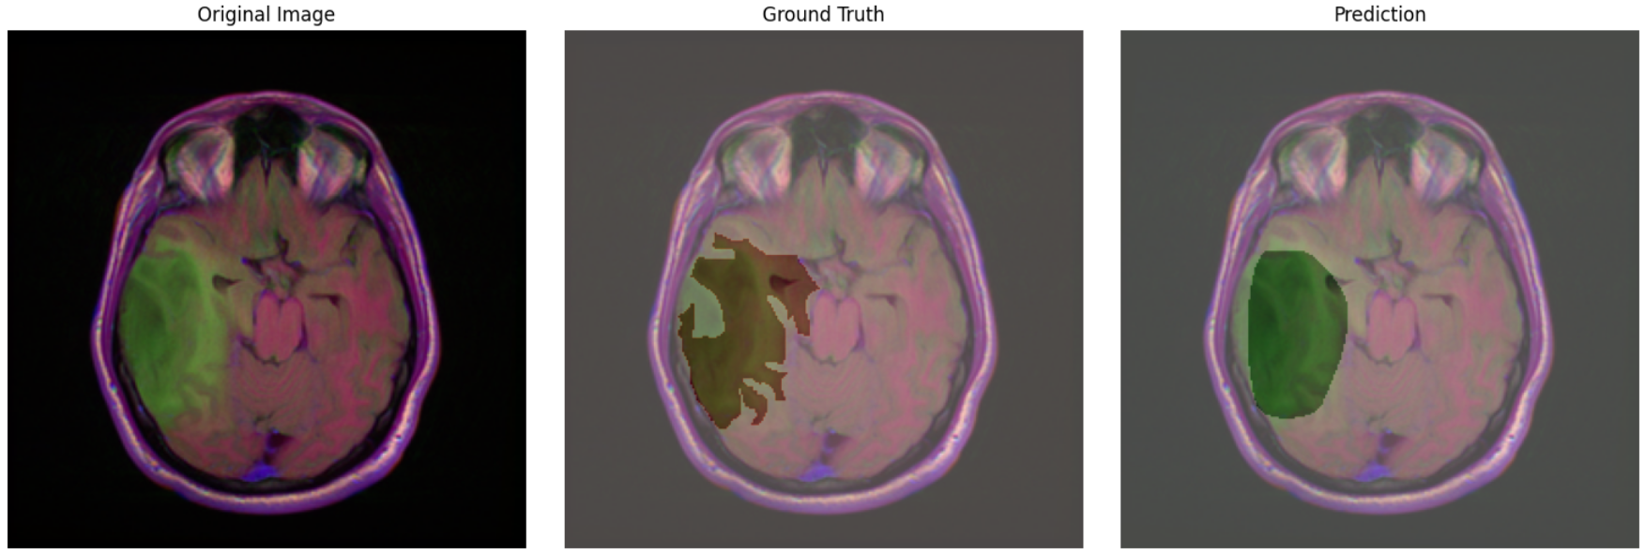




NeuroScanAI — Brain Tumor Detection & Segmentation
Two‑stage Deep Learning Pipeline (ResNet50 + ResUNet)
Deep Learning
Medical AI
Tumor Analysis

Slide 2
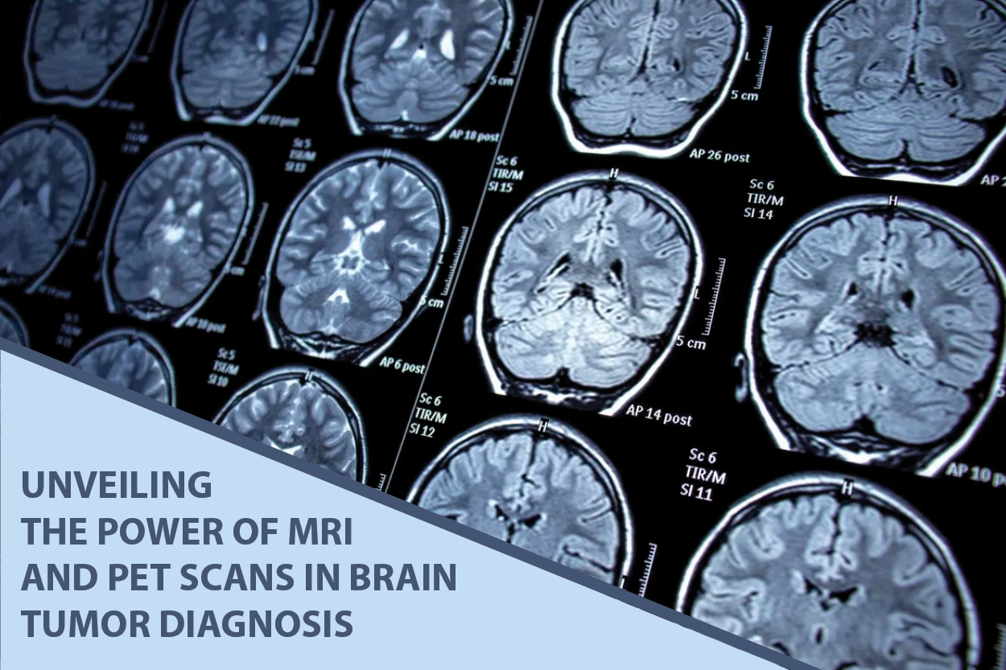



Problem & Motivation
Critical Impact
Brain tumors are deadly; early detection saves lives
Manual Limitation
Manual segmentation is slow and expensive
AI Solution
AI can screen + localize tumors efficiently
Automation transforms radiology workflows by accelerating diagnosis and reducing clinical workload

Slide 3
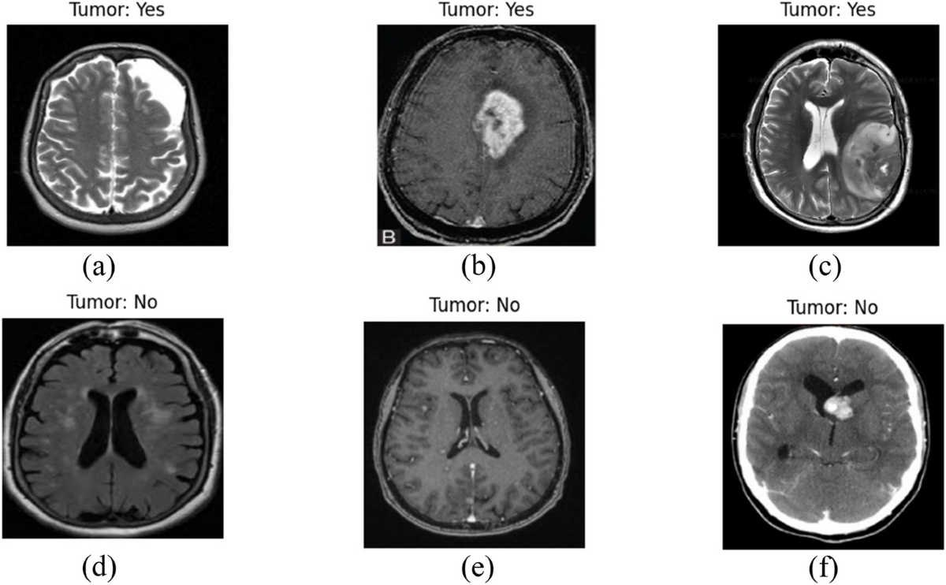



Data & Preprocessing
Dataset Source
LGG MRI Segmentation (Kaggle)
Dataset Scale
110 patients, MRI slices + tumor masks
Preprocessing
Resized to 256×256, normalized to [0,1]
Data Pipeline
tf.data pipeline + multi‑GPU (2×T4)
MRI slice with tumor segmentation overlay (crimson highlight)
2,556
1,373
Healthy Slices
Tumor Slices

Slide 4









Two-Stage Pipeline Overview
MRI Input
ResNet50
Detection?
ResUNet
Output
Brain scan
Classifier
Tumor present
Segmentor
Overlay + Heatmap
Gatekeeper
False Positive Control
Cascade System
Classifier reduces compute cost by filtering healthy scans
Segmentor acts as safety filter, eliminating false positives
Two-stage design maximizes accuracy while minimizing resources

Slide 5
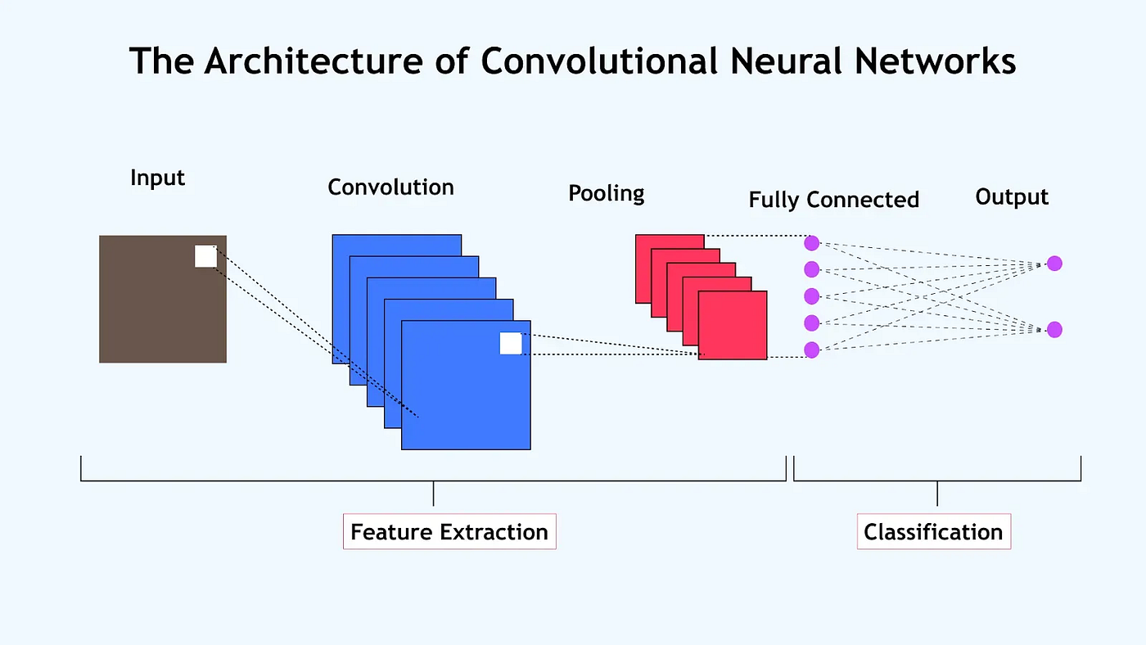





Stage 1: Classification
ResNet50
Architecture
Pretrained ResNet50 + custom classification head
Loss Function
Categorical cross-entropy
Training Parameters
Adam optimizer, LR = 1e-4, 30 epochs
Fine-Tuning Strategy
Unfreeze top layers, reduced LR = 1e-5
Transfer learning from ImageNet weights enables rapid convergence on medical images

Slide 6





Classification Optimization
Fixed Class Weights
Clean Augmentation
Calculated from training subset only
Resolved double-augmentation bugs
Tumour: 1.43, Healthy: 0.77
Spatial + pixel-level augmentations
Threshold Sweep
Optimal Threshold
Systematic exploration 0.15 → 0.50
Clinical threshold: 0.25
Balancing precision and recall
Minimizes false negatives
Clinical Priority: Reduce False Negatives
Aggressive thresholding catches 95.59% of tumors. False positives are acceptable as they're filtered by the segmentation stage. Patient safety takes precedence over absolute accuracy.

Slide 7
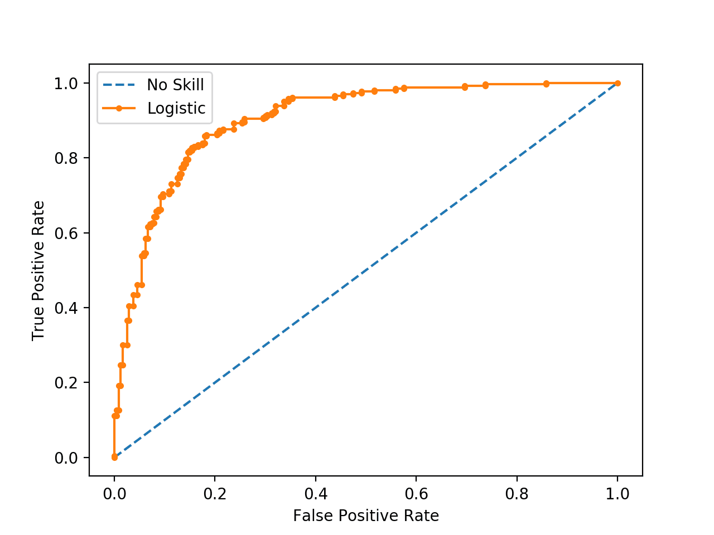



ROC-AUC: 0.9564
Classification Results
Model Choice
Chosen Model
ResNet50 Phase 2 @ 0.25
System Accuracy
84.07%
Tumor Recall
95.59%
DenseNet121 Rejected
Higher false negative risk despite better ROC-AUC

Slide 8
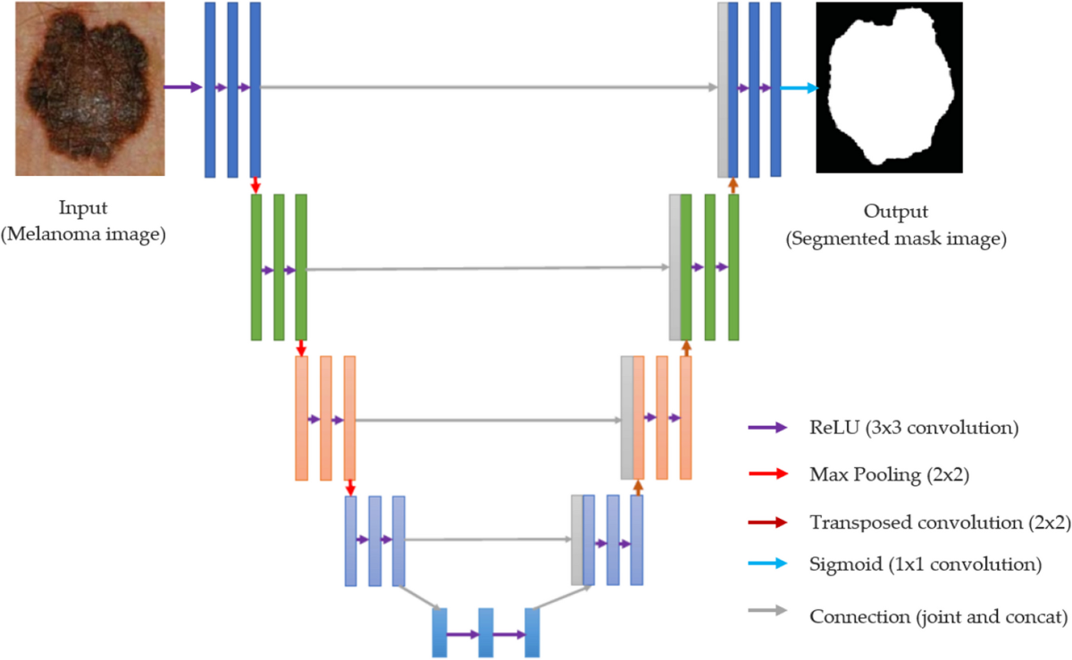




Stage 2: Segmentation
ResUNet Architecture
Encoder
Pretrained ResNet50 feature extractor
Captures robust low-level & high-level medical textures
Decoder
U-Net with skip connections
Recovers spatial resolution, preserves boundaries
Output
256 × 256 × 1 binary mask
Pixel-level tumor localization with Sigmoid activation
Skip connections ensure precise boundary preservation for pixel-level accuracy

Slide 9







Segmentation Evolution
35%
47.3%
51.5%
Baseline
Phase B
Phase C
BCE + Dice Loss
Data Augmentation
Focal Tversky Loss
Hallucinated false positives
Improved but suboptimal
Optimal performance
Focal Tversky Loss
Hyperparameters
Key Achievement
Replaced BCE to address FN/FP imbalance. Penalizes difficult tumor boundary pixels more heavily.
α = 0.3 (False Negative penalty)
Eliminated false-positive hallucinations on healthy scans. Forced model to focus on tumor boundary pixels.
β = 0.7 (False Positive penalty)
γ = 0.75 (Focusing parameter)

Slide 10
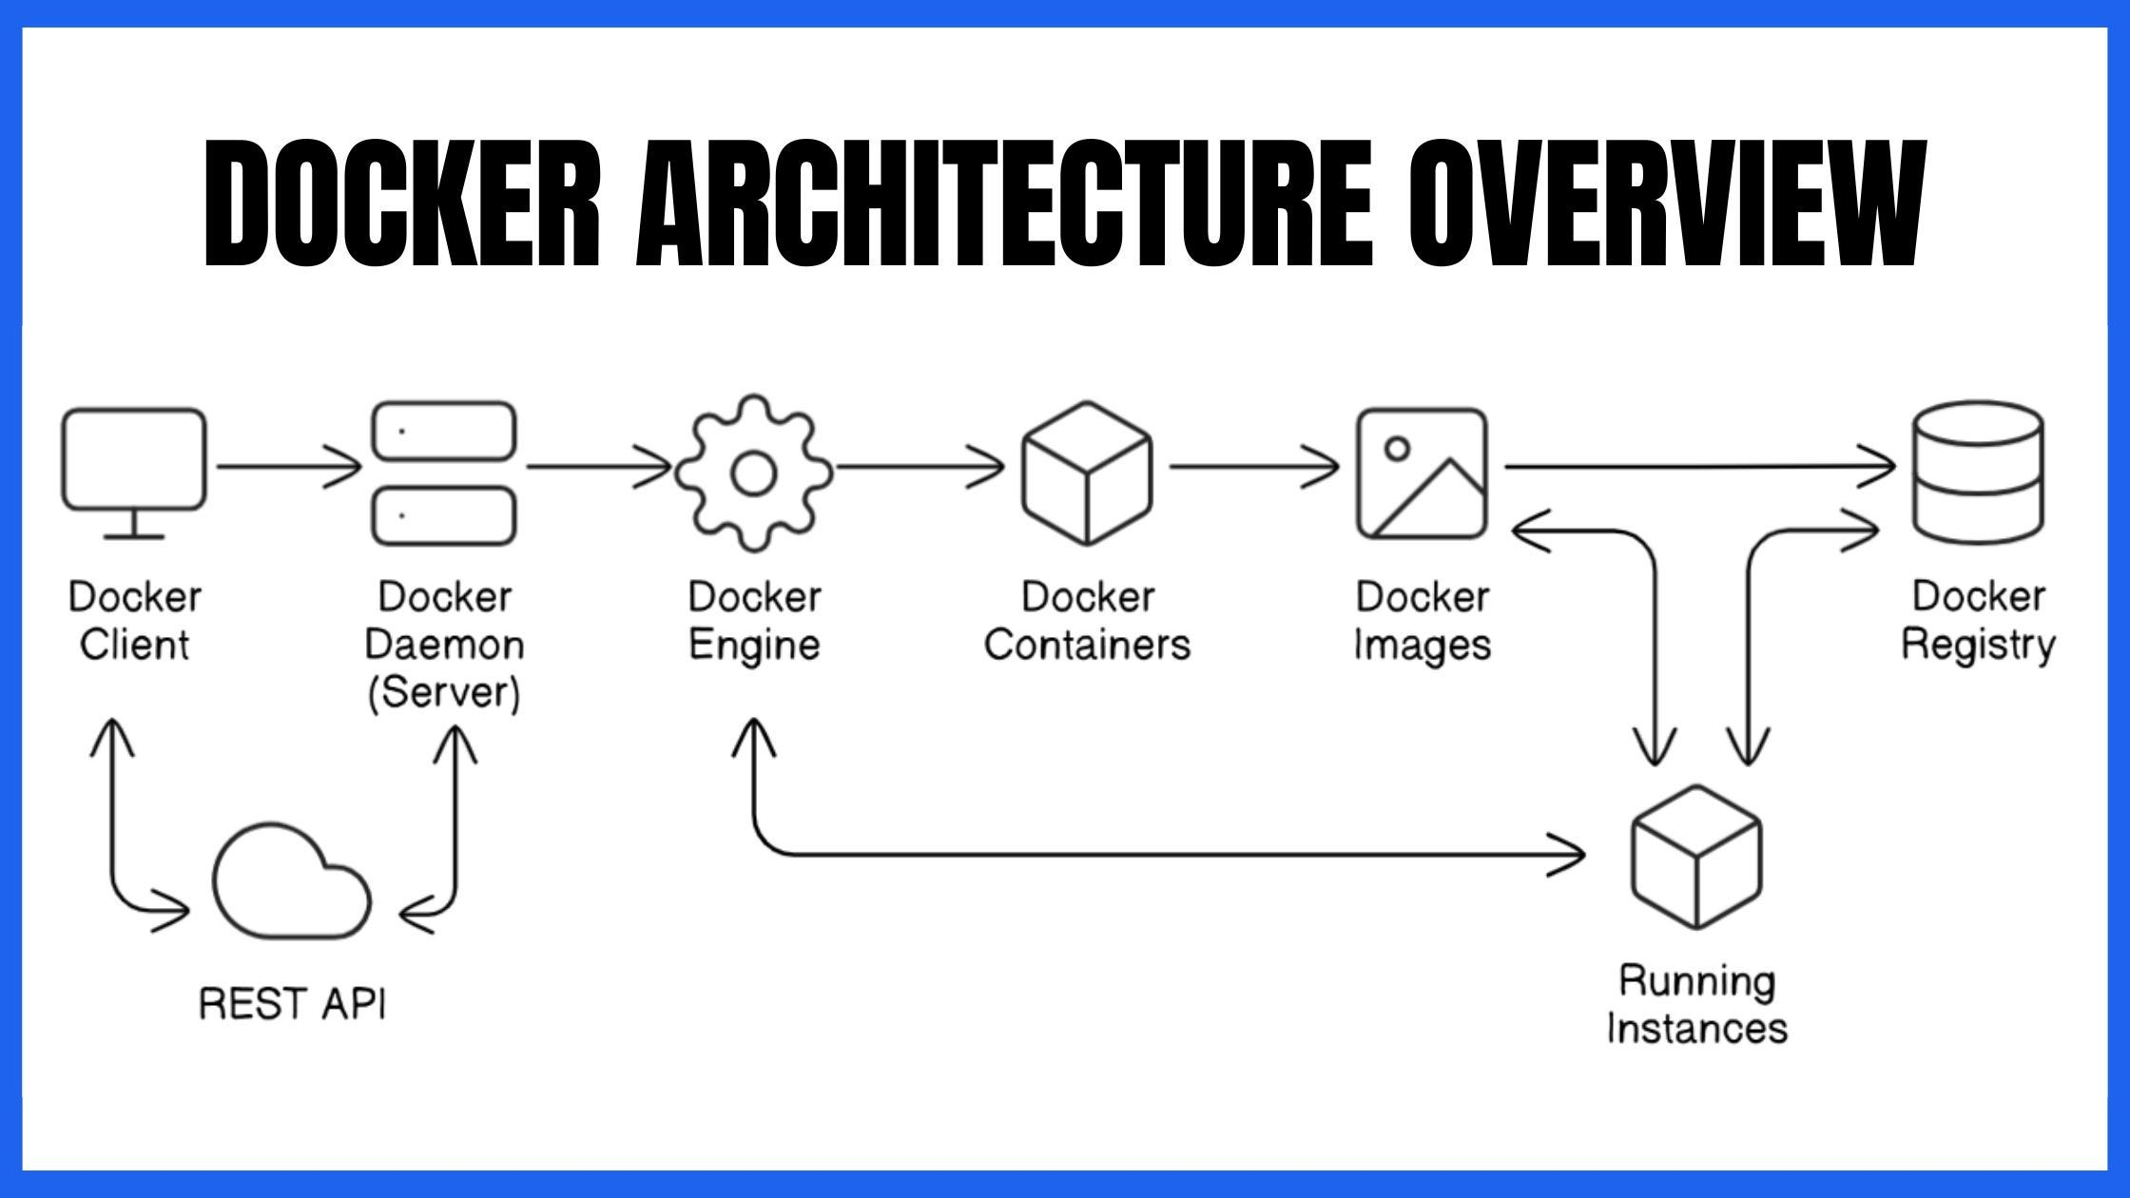





Final Output + Deployment
Models Exported
brain_tumor_resnet50_pipeline_f.keras
Brain_Tumor_Segmentation_FTL_Winner.keras
Tech Stack
Deployment
FastAPI Backend
Dockerized
Next.js Frontend
AWS-Ready
Production Ready
End-to-end pipeline with reproducible deployment artifacts
Containerized Deployment Architecture

